Slide 1
Verilog HDL语言
设计入门
主讲：李榕
Email: lr@mail.hust.edu.cn
QQ: 179825425
华中科技大学计算机科学与技术学院

Slide 2
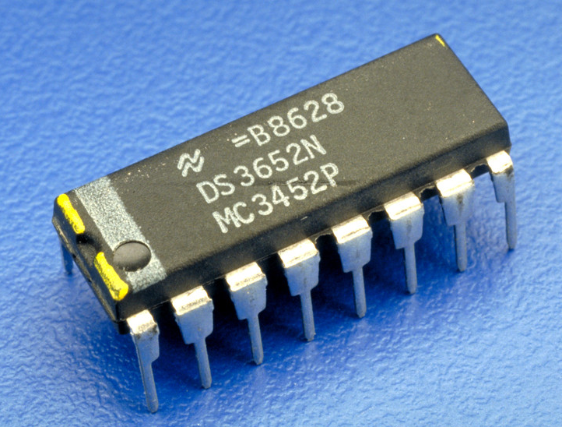
如何去描述一个 IC
1. IC

Slide 3
Verilog程序的最基本结构
模块（module）是Verilog的基本描述单位，用于描述某个设计的功能或结构，及其与其他模块通信（连接）的外部端口。
一个模块可以在另一个模块中使用。

Slide 4
Verilog程序由关键词module和endmodule进行定义
Verilog HDL 大小写敏感
module name (port_list);
port declarations
data type declarations
functionality
timing specification
endmodule

Slide 5
Verilog程序的组成部分
module Name，
port list， port declarations（if ports present）
parameters（optional），
这5个组件的排列顺序是任意的，可以选择其中的一个或几个组件构成一个Verilog程序。
Declarations of wires,
regs and other variables
Data flow statements
( assign )
Instantiation of lower level modules
Tasks and functions
Always and initial blocks,
All behavioral statements go in these blocks.
endmodule

Slide 6
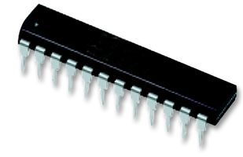
Verilog 模块
module name
ports names of module
A[1:0]
2
module decoder_2_to_4 (A, D) ;
input [1:0] A ;
output [3:0] D ;
assign D = (A == 2'b00) ? 4'b0001 :
(A == 2'b01) ? 4'b0010 :
(A == 2'b10) ? 4'b0100 :
(A == 2'b11) ? 4'b1000 ;
endmodule
Decoder
2-to-4
port types
port sizes
4
D[3:0]
module contents
keywords underlined

Slide 7
如何实现一个模块
Verilog语言的关键词不能用作模块名
（例如：module/port/signal 等）
Choose a descriptive module name
定义模块的端口（connectivity）
Choose descriptive signal names
遵照工程惯例，例如：地址总线 – addr，数据总线 – data，输入 – A，输出 – D/Q….
定义模块内部连接到端口的信号类型
定义内部信号
描述模块内部实现的功能（ functionality）

Slide 8
定义端口
每个端口都会连接一个信号（Signal）
申明端口的类型
input
output
inout （双向）
Scalar (single bit) - 不需要给出信号的位数
input cin;
Vector (multiple bits) - 需要定义具体的位数
Range is msb to lsb (left to right)
Don’t have to include zero if you don’t want to… (D[2:1])
output [7:0] OUT;
input [0:4] IN;

Slide 9
模块端口列表
模块端口的多种申明方法（例1）
module Add_half(c_out, sum, a, b);
output sum, c_out;
input a, b;
…
endmodule
module Add_half(output c_out, sum,
input a, b);
…
endmodule

Slide 10
模块端口列表
模块端口的多种申明方法（例2）
module xor_8bit(out, a, b);
output [7:0] out;
input [7:0] a, b;
…
endmodule
module xor_8bit(output [7:0] out, input [7:0] a, b);
…
endmodule

Slide 11
结构描述
一般使用内部元件（Primitive）、自定义的下层模块对电路进行描述。主要用于层次化设计中。
module mux2_1(out1,a,b,sel);
output out1;
input a,b,sel;
not (sel_, sel);
and (a1, a, sel_);
and (b1, b, sel);
or (out1, a1, b1);
endmodule

Slide 12
数据流描述
一般使用连续赋值assign语句描述，主要用于组合逻辑电路建模。
module mux2_1(out1, a, b, sel) ;
output out1;
input a, b;
input sel;
assign out1=(sel & b) | (~sel & a);
endmodule

Slide 13
行为描述
一般使用Initial或Always语句描述，可以对组合、时序逻辑电路建模。
module mux2_1(out1, a, b, sel) ;
output reg out1;
input a, b;
input sel;
always @(sel or a or b)
begin
if (sel)
out1 = b;
else
out1 = a;
end
endmodule
module mux2_1(out1, a, b, sel) ;
output reg out1;
input a, b;
input sel;
always @(sel or a or b)
begin
case (sel)
1’b0 : out1 = a;
1’b1 : out1 = b;
endcase
end
endmodule

Slide 14
混合设计描述
结构、数据流和行为描述方式可以自由混合。模块描述中可以包含实例化的门、模块实例化语句、连续赋值语句以及a l w a y s语句和i n i t i a l语句的混合。它们之间可以相互包含。
来自a l w a y s语句和i n i t i a l语句（切记只有寄存器类型数据可以在这两种语句中赋值）的值能够驱动门或开关。
而来自于门或连续赋值语句（只能驱动线网）的值能够反过来用于触发a l w a y s语句和i n i t i a l语句。

Slide 15
实例：混合设计方式的1位全加器
module FA_Mix(A,B,Cin,Sum,Cout);
input A,B,Cin;
output Sum,Cout;
reg Cout;
reg T1,T2,T3;
wire S1;
xor X1(S1,A,B); //门实例语句
always @ (A or B or Cin) //always 语句
begin
T1 = A & B;
T2 = A & Cin;
T3 = B & Cin;
Cout = (T1 | T2) | T3;
end
assign Sum = S1 ^ Cin; //连续赋值语句
endmodule

Slide 16
设计验证与仿真
Verilog HDL不仅提供描述设计的能力，而且提供对激励、控制、存储响应和设计验证的建模能力。
激励和控制可用初始化语句产生。验证运行过程中的响应可以作为“变化时保存”或作为选通的数据存储。
最后，设计验证可以通过在初始化语句中写入相应的语句自动与期望的响应值比较完成。
要测试一个设计块是否正确，就要用Verilog再写一个测试模块。这个测试模块应包括以下三个方面的内容：
测试模块中要调用到设计块，只有这样才能对它进行测试；
测试模块中应包含测试的激励信号源；
测试模块能够实施对输出信号的检测，并报告检测结果。

Slide 17
HDL电路的仿真与验证
残酷的现实……
设计用时10%，而用于设计验证的时间则占 90%
如果方法不当验证用时甚至更多
Testbenchs也是用Verilog语言写的。
Testbench Verilog不是用来描述硬件的，更像是一个测试程序。
Stimulus
Generation
(verilog)
Design
Under Test
(verilog)
Output
Monitoring
Self Checking
(verilog)
file
Verilog test bench shell
file

Slide 18
Testbench实例（仅用于演示）
module test_and;
integer file, i, code;
reg a, b, expect, clock;
wire out;
parameter cycle = 20;
and #4 a0(out, a, b); // Circuit under test
initial begin : file_block
clock = 0;
file = $fopen("compare.txt", “r” );
for (i = 0; i < 4; i=i+1) begin
@(posedge clock) // Read stimulus on rising clock
code = $fscanf(file, "%b %b %b\n", a, b, expect);
#(cycle - 1) // Compare just before end of cycle
if (expect !== out)
$strobe("%d %b %b %b %b", $time, a, b, expect, out);
end // for
$fclose(file); $stop;
end // initial
always #(cycle /2) clock = ~clock; // Clock generator
endmodule

Slide 19
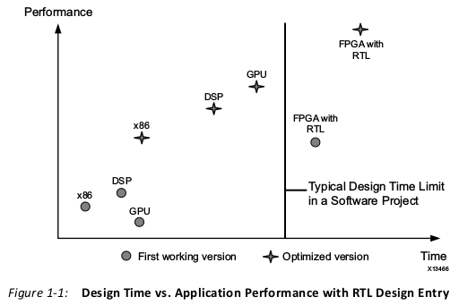

Slide 20
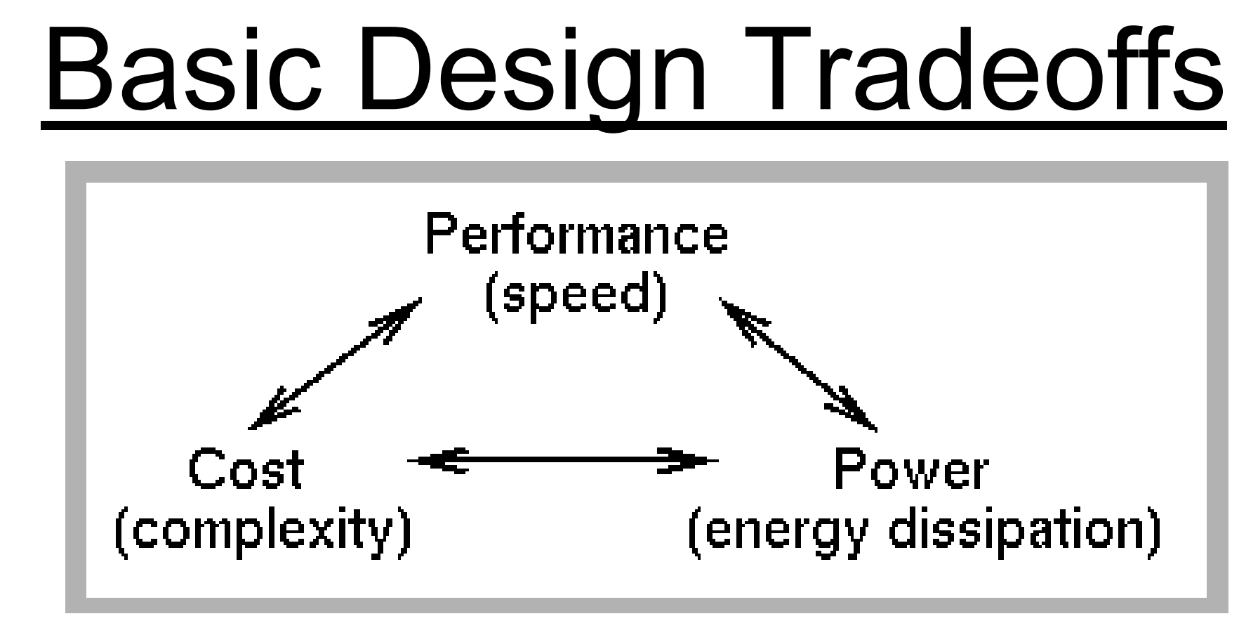

Slide 21
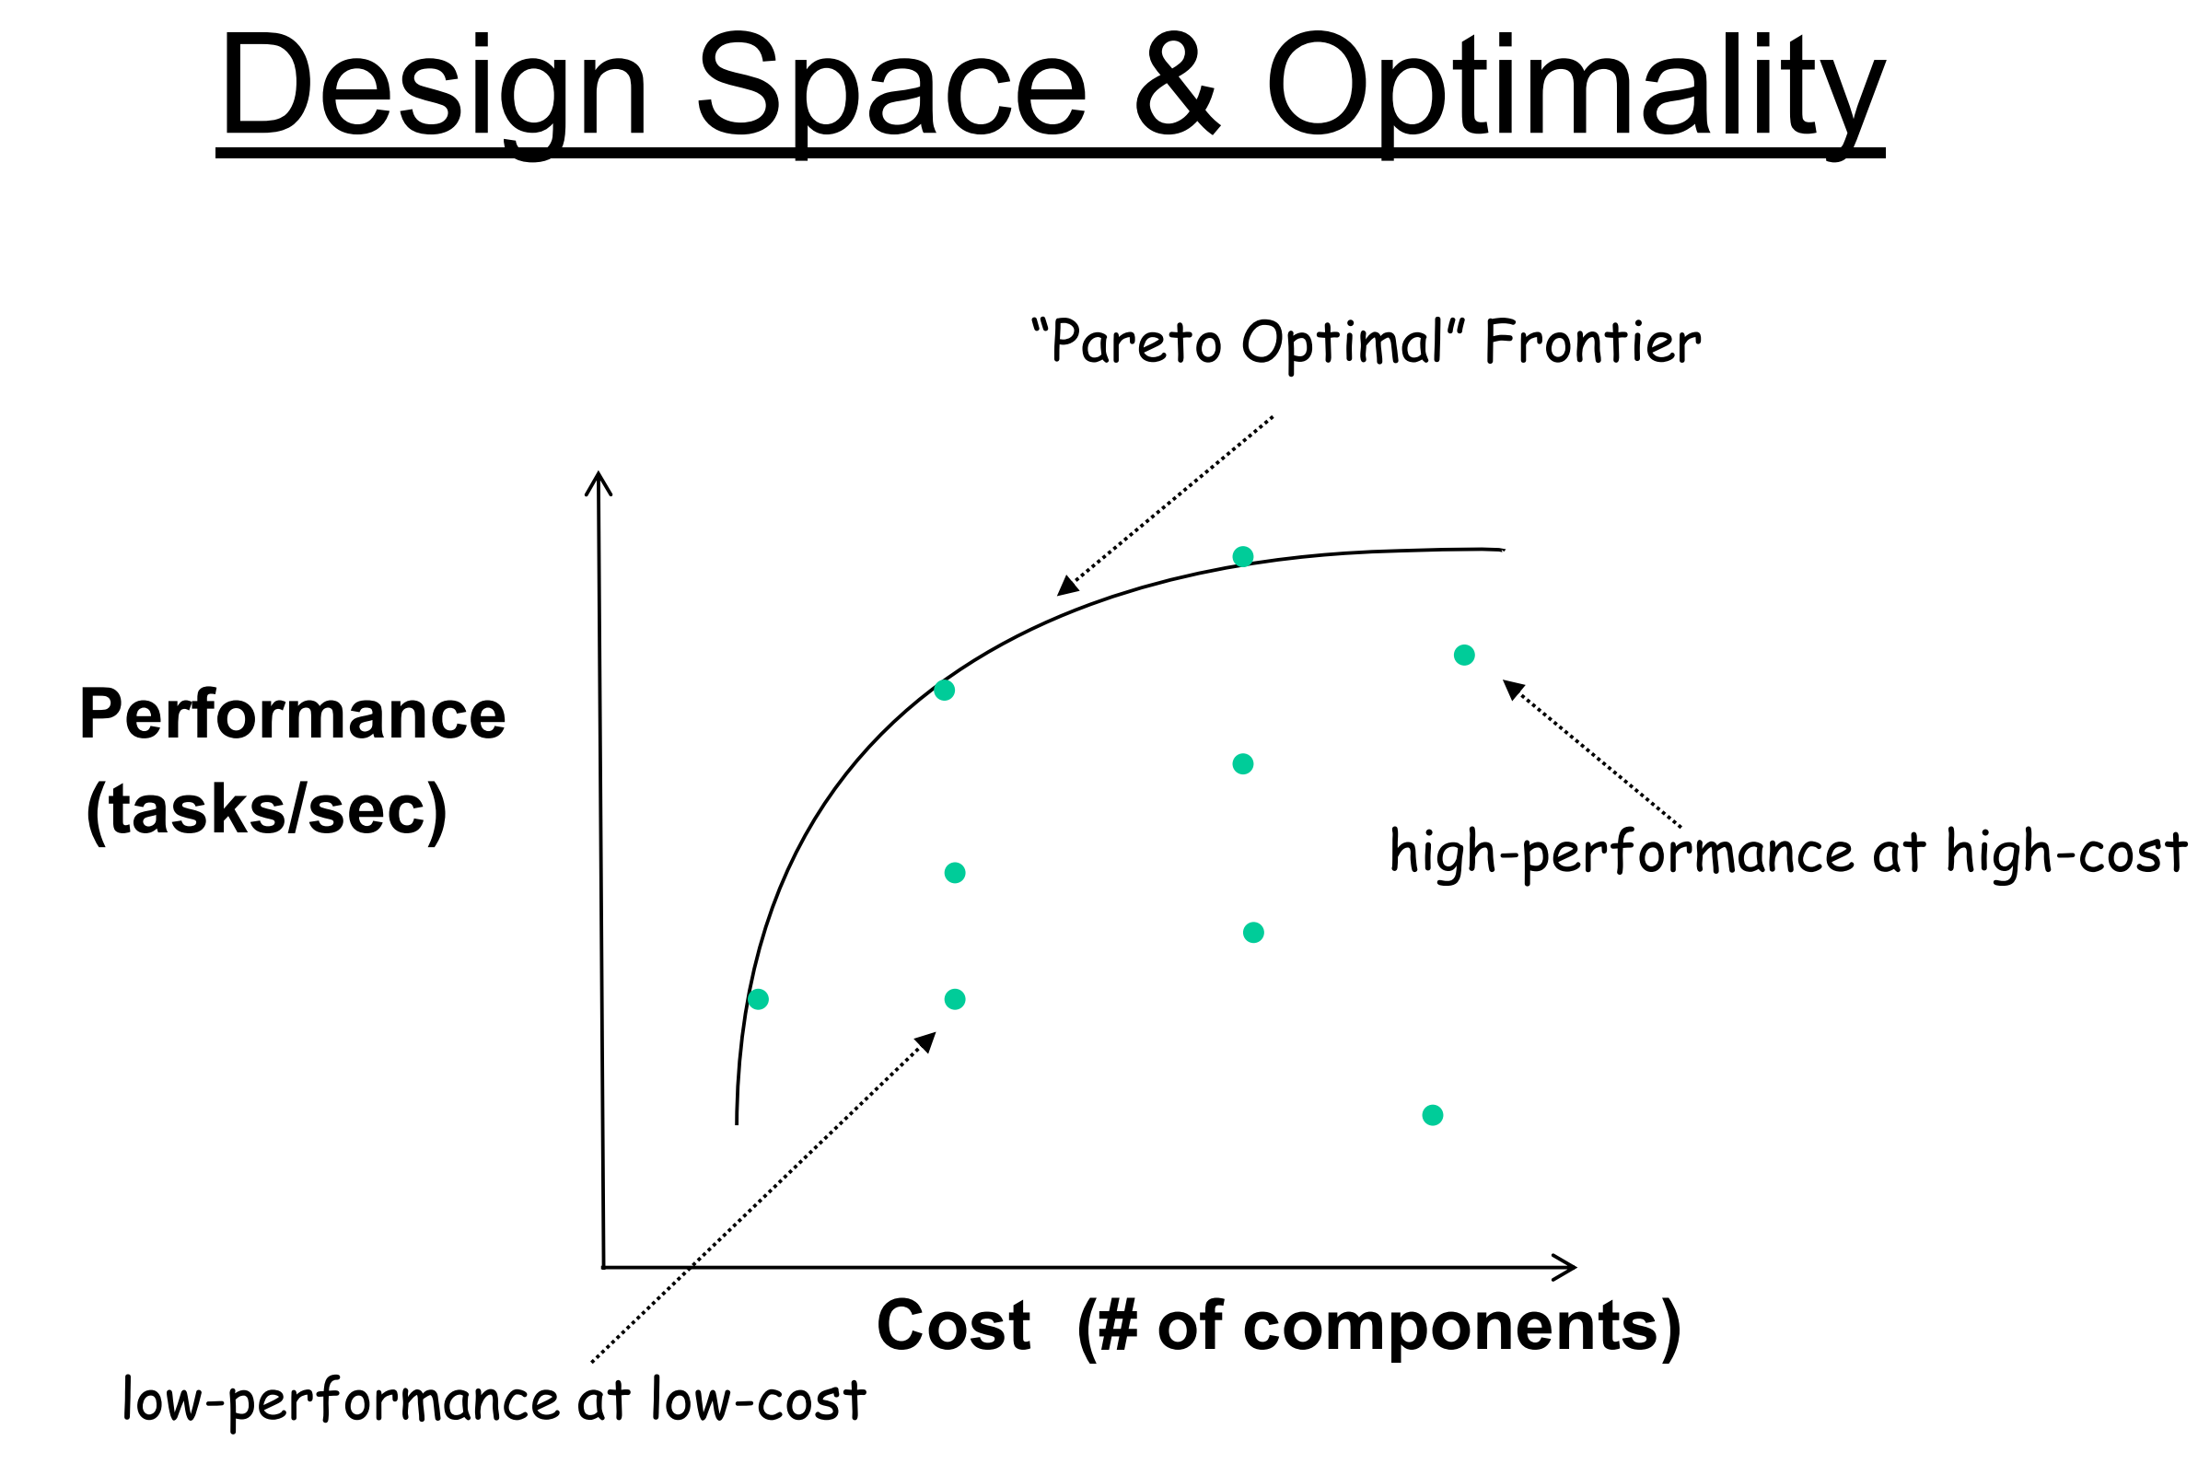
帕雷托最优

Slide 22
Comments in Verilog
Commenting is important
In industry many other poor schmucks are going to read your code
Some poor schmuck (perhaps you 4 years later) are going to have to reference your code when a customer discovers a bug.
The best comments document why you are doing what you are doing, not what you are doing.
Any moron who knows verilog can tell what the code is doing.
Comment why (motivation/thought process) you are doing that thing.
Slide taken direct from Eric Hoffman

Slide 23
Commenting in Verilog
always @(posedge clk)
begin
Sig_FF1 <= Sig // Capture value of Sig Line in FF
Sig_FF2 <= Sig_FF1; // Flop Sig_FF1 to form Sig_FF2
Sig_FF3 <= Sig_FF2; // Flow Sig_FF2 to form Sig_FF3
end
// start_bit is ~Sig_FF2 & Sig_FF3
assign start_bit = (~Sig_FF2 && Sig_FF3) ? 1’b1 : 1’b0;
(Read with sarcasm)
“Thanks for the commenting the code pal. It tells me so much more than the verilog itself”.
Slide taken direct from Eric Hoffman

Slide 24
Commenting in Verilog
always @(posedge clk)
/********************************************
* Sig is ansynchronous and has to be double flopped *
* for meta-stability reasons prior to use ************
*********************************/
begin
Sig_FF1 <= Sig;
Sig_FF2 <= Sig_FF1; // double flopped meta-stability free
Sig_FF3 <= Sig_FF2; // flop again for use in edge detection
end
/**********************************************
* Start bit in protocol initiated by falling edge of Sig line *
**********************************************/
assign start_bit = (~Sig_FF2 && Sig_FF3) ? 1’b1 : 1’b0;
Can see 2 types
of comments.
Comment to end of line is //
Multi line comment starts with /* and ends with */
This is better commenting. It tells you why stuff was done
Slide taken direct from Eric Hoffman

Slide 25
Verilog语言基础

Slide 26
间隔符：空格、TAB键、换行符及换页符
注释
单行注释用//标志起头和回车符结尾
多行注释用/*标志起头和*/标志结尾
标识符
可以是任意一组字母、数字、$符号和_(下划线)符号的组合；
必须是由字母或下划线开头，长度小于1024字符；
转义标识符以反斜杠“\”开头，以空白符结尾的任何字符序列；
标识符区分大、小写。
关键词：Verilog HDL 内部已使用的词，关键词都是小写。
格式：区分大小写。自由格式，即结构可以跨越多行编写。

Slide 27
Identifiers (Signal Names)
Identifiers are the names you choose for your signals
In a programming language you should choose descriptive variable names. In a HDL you should choose descriptive signal names.
Use mixed case and/or _ to delimit descriptive names.
assign parityErr = ^serial_reg;
nxtState = returnRegister;
Have a convention for signals that are active low
Many errors occur on the interface between blocks written by 2 different people. One assumed a signal was active low, and the other assumed it was active high
I use _n at the end of a signal to indicate active low
rst_n = 1’b0 // assert reset
Slide taken direct from Eric Hoffman

Slide 28
Verilog 基础知识
四种基本的值
0：逻辑0或“假”
1：逻辑1或“真”
x：未知
z：高阻
三类常量
整型数：简单的十进制格式，基数格式（5’O37，4’B1x_01）
实数：十进制计数法，科学计数法
字符串：字符串是双引号的字符序列，字符串不能分成多行书写
参数
参数是一个常量，经常用于定义时延和变量的宽度等。
信号等级 | 信 号 强 度 | 关 键 字
7 | Supply Drive | supply0 | supply1
6 | Strong Drive | strong0 | strong1
5 | Pull Drive | pull0 | pull1
4 | Large Capacitance | large
3 | Weak Drive | weak0 | weak1
2 | Medium Capacitance | medium
1 | Small Capacitance | small
0 | Hi Impedance (no drive) | highz0 | highz1

Slide 29
Resolving 4-Value Logic
S
A
OUT
A
OUT
A
T
OUT
B
B
B
A B OUT
A B OUT
S A T B OUT
0 0 0
0 1 1
1 1 1
0 x
0 z
1 x
1 z
0 0 0
0 1 0
1 1 1
0 x
0 z
1 x
1 z
0 0 z z
0 1 z x
0 x z 1
0 z z 0
1 0 0 1
1 0 0 z
1 1 1 z
1 x x z
1 z x 0
z
x
1
X
0
0
X
0
x
1
x
0
1
x
1
x
x
OUT
A
OUT
0 1 x z
1 0 x
A
X
Slide taken direct from Eric Hoffman

Slide 30
Numbers in Verilog
General format is: <size>’<base><number>
Examples:
4’b1101 // this is a 4-bit binary number equal to 13
10’h2e7 // this is a 10-bit wide number specified in hex
Available bases:
d = decimal (please only use in test benches)
h = hex (use this frequently)
b = binary (use this frequently for smaller #’s)
o = octal (who thinks in octal?, please avoid)
Slide taken direct from Eric Hoffman

Slide 31
Numbers in Verilog
Numbers can have x or z characters as values
x = unknown, z = High Impedance
12’h13x // 12-bit number with lower 4-bits unknown
If size is not specified then it depends on simulator/machine.
Always size the number for the DUT verilog
Why create 32-bit register if you only need 5 bits?
May cause compilation errors on some compilers
Supports negative numbers as well
-16’h3A // this would be -3A in hex (i.e. FFC6 in 2’s complement)
I rarely if ever use this. I prefer to work 2’s complement directly
Slide taken direct from Eric Hoffman

Slide 32
Parameters & Define
Parameters are useful to make your code more generic/flexible. Read about it in text. More later…
`define statement can make code more readable
`define idle = 2’b00; // idle state of state machine
`define conv = 2’b01; // in this state while A2D converting
`define avg = 2’b10; // in this state while averaging samples
.
.
.
case (state)
`idle : if (start_conv) nxt_state = `conv;
else nxt_state = `idle
`conv : if (gt) nxt_state = `avg;
else nxt_state = `conv;
.
.
.
Bad Example…Don’t Use `define for state assignment
Use parameters instead. `define should be truly global thing
Slide taken direct from Eric Hoffman

Slide 33
Parameters & Define
localparam idle = 2’b00; // idle state of state machine
localparam conv = 2’b01; // in this state while A2D converting
localparam accum = 2’b10; // in this state while averaging samples
.
.
.
case (state)
idle : if (start_conv) nxt_state = conv;
else nxt_state = idlle
conv : if (gt) nxt_state = avg;
else nxt_state = conv;
.
.
.
Slide taken direct from Eric Hoffman

Slide 34
数据类型
线网类型（wire）。net type表示Verilog结构化元件间的物理连线。它的值由驱动元件的值决定；如果没有驱动元件连接到线网，线网的缺省值为z。
寄存器类型（reg）。register type表示一个抽象的数据存储单元，它只能在always语句和initial语句中被赋值，并且它的值从一个赋值到另一个赋值被保存下来。寄存器类型的变量具有x的缺省值。

Slide 35
Nets数据类型：表示元件之间的结构化连接
wire和tri线网：是最常见的线网类型。
wor和trior线网：如果某个驱动源为1，那么线网的值也为1。
wand和triand线网：如果某个驱动源为0，那么线网的值为0。
trireg线网：此线网存储数值（类似于寄存器），并且用于电容节点的建模。
tri0和tri1线网：这类线网可用于线逻辑的建模，即线网有多于一个驱动源。
supply0和supply1线网：supply0用于对“地”建模，即低电平0；supply1用于对电源建模，即高电平1。

Slide 36
Register数据类型：在程序块中作变量用，对信号赋值需要用该数据类型，赋值时用关键字initial或always开始。
reg寄存器类型：是最常见的数据类型。
integer寄存器类型：整数寄存器包含整数值，可以作为普通寄存器使用，典型应用为高层次行为建模。
time类型：用于存储和处理时间。
real和realtime类型：实数寄存器（或实数时间寄存器）。

Slide 37
Registers in Verilog
Registers are storage nodes
They retain their value till a new value is assigned
Unlike a net (wire) they do not need a driver
Can be changed in simulation by assigning a new value
Registers are not necessarily FlipFlops
In your DUT Verilog registers are typically FlipFlops
Anything assigned in an always or initial block must be assigned to a register
You will use registers in your testbenches, but they will not be FlipFlops
Slide taken direct from Eric Hoffman

Slide 38
Vectors in Verilog
Vectors are a collection of bits (i.e. 16-bit wide bus)
////////////////////////////////////////////////////////////////////
// Define the 16-bit busses going in and out of the ALU //
//////////////////////////////////////////////////////////////////
wire [15:0] src1_bus,src2_bus,dst_bus;
///////////////////////////////////////////////////////////////
// State machine has 8 states, need a 3-bit encoding //
/////////////////////////////////////////////////////////////
reg [2:0] state,nxt_state;
Slide taken direct from Eric Hoffman

Slide 39
Vectors in Verilog
Can select parts of a vector (single bit or a range)
module lft_shift(src,shft_in,result,shft_out);
input [15:0] src;
input shft_in;
output [15:0] result;
output shft_out;
/////////////////////////////////////////////////////////////////////////
// Can access 15 LSB’s of src with [14:0] selector //
// { , } is a process of concatenating two vectors to form one //
//////////////////////////////////////////////////////////////////////
assign result = {src[14:0],shft_in};
assign shft_out = src[15]; // can access a single bit MSB with [15]
endmodule
src
16
shft_out
left shift
shft_in
16
result
Slide taken direct from Eric Hoffman

Slide 40
Arrays & Memories
Can have multi-dimentional arrays
reg [7:0] mem[0:99][0:3]; // what is this?
addr1
Often have to model memories
RF, SRAM, ROM, Flash, Cache
Memories can be useful in your test bench
RF
Flash
I²C
addr2
src1
src2
ALU
wire [15:0] src1,src2; // source busses to ALU
reg [15:0] reg_file[0:31];// Register file of 32 16-bit words
reg [4:0] addr1,addr2; // src1 and src2 address
.
.
.
src1 = reg_file[addr1]; // transfer addressed register file
// to src1 bus
result
Slide taken direct from Eric Hoffman

Slide 41
系统任务和函数
以$字符开始的标识符表示系统任务或系统函数；
任务提供了一种封装行为的机制，任务可以返回0个或多个值；
函数除只能返回一个值以外与任务相同；
函数在0时刻执行，即不允许延迟，而任务可以带有延迟。
编译指令：以`（反引号）开始的某些标识符
`define和`undef，`ifdef、`else和 `endif，`default_nettype
`include，`resetall，`timescale
`unconneted_drive和`nounconnected_drive
`celldefine和`endcelldefine

Slide 42
Useful System Tasks
$display: Like printf in C. Useful for testbenches and debug
$display(“At time %t count = %h”,$time,cnt);
$stop ➔ Stops simulation and allows you to still probe signals and debug
$finish ➔ completely stops simulation, simulator relinquishes control of thread.
Also useful is `include for including code from another file (like a header file)
Read about these features of verilog in your text
Slide taken direct from Eric Hoffman

Slide 43
时延
Verilog HDL模型中的所有时延都根据单位定义。
下面是带时延的连续赋值语句实例：
assign #2 Sum = A ^ B;
#2指2个时间单位。
如果没有说明时延时间单位，Verilog HDL模拟器会指定一个缺省时间单位。
IEEE Verilog HDL标准中没有规定缺省时间单位。

Slide 44
Delay Examples
wire #5 net_1; // 5 unit transport delay
and #4 (z_out, x_in, y_in); // 4 unit inertial delay
assign #3 z_out = a & b; // 3 unit inertial delay
wire #2 z_out; // 2 unit transport delay
and #3 (z_out, x_in, y_in); // 3 for gate, 2 for wire
wire #3 c; // 3 unit transport delay
assign #5 c = a & b; // 5 for assign, 3 for wire
Slide taken direct from Eric Hoffman

Slide 45
Types Of Delays
Inertial Delay (Gates)
Suppresses pulses shorter than delay amount
In reality, gates need to have inputs held a certain time before output is accurate
This models that behavior
Transport Delay (Nets)
“Time of flight” from source to sink
Short pulses transmitted
Not critical for our project, however, in industry
After APR(Automatic Placement & Routing) an SDF(Standard Delay Format) is applied for accurate simulation
Then corner simulations are run to ensure design robust
Slide taken direct from Eric Hoffman

Slide 46
Timing Controls For Simulation
Can put “delays” in a Verilog design
Gates, wires, & behavioral statements
Delays are useful for Simulation only!
Used to approximate “real” operation while simulating
Used to control testbench
SYNTHESIS
Synthesis tool IGNORES these timing controls
Cannot tell a gate to wait 1.5 nanoseconds
Delay is a result of physical properties
Only timing (easily) controlled is on clock-cycle basis
Can tell synthesizer to attempt to meet cycle-time restriction
Slide taken direct from Eric Hoffman

Slide 47
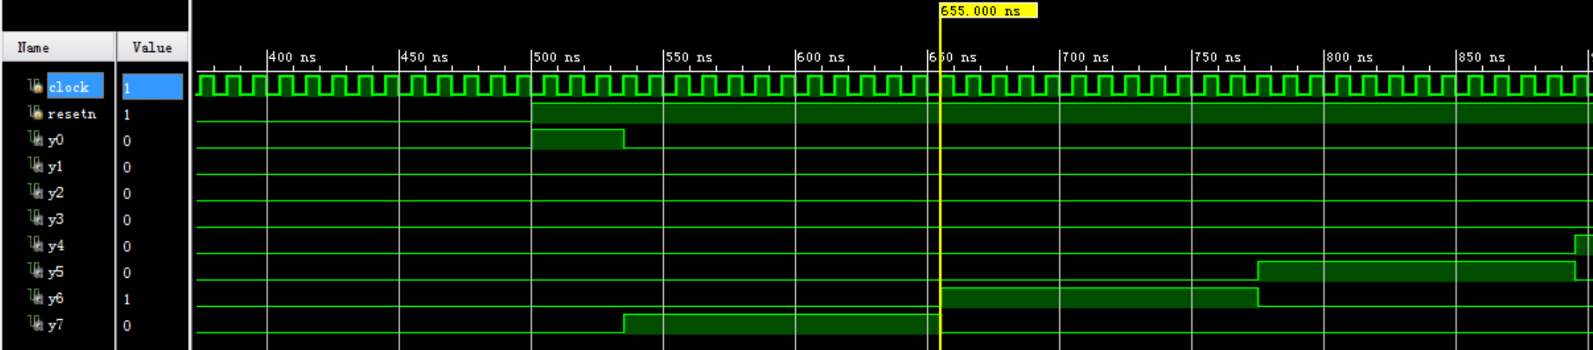
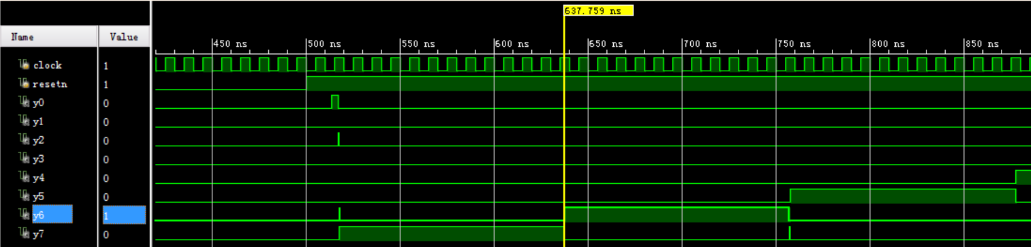

Slide 48
Verilog 运算符
运算符（9类）
算术运算符： +、-、*、/、%
位运算符： ~、&、|、^、^~、~^
缩位运算符（单目）： &、~&、|、~|、^、^~、~^
逻辑运算符： !、&&、||
关系运算符（双目）： <、>、<=、>=
相等与全等运算符： ==、!=、===、!==
逻辑移位运算符： <<、>>
连接运算符： { }
条件运算符： ? :

Slide 49
Reduction Operators
Reduction operators are reduce all the bits of a vector to a single bit by performing an operation across all bits.
Reduction AND
assign all_ones = &accumulator; // are all bits set?
Reduction OR
assign not_zero = |accuumulator; // are any bits set?
Reduction XOR
assign parity = ^data_out; // even parity bit

Slide 50
Vector concatenation
Can “build” vectors using smaller vectors and/or scalar values
Use the {} operator
Example 1
becomes 8-bit vector:
a₁a₀b₁b₀c₁c₀da₂
module concatenate(out, a, b, c, d);
input [2:0] a;
input [1:0] b, c;
input d;
output [9:0] out;
assign out = {a[1:0],b,c,d,a[2]};
endmodule
Slide taken direct from Eric Hoffman

Slide 51
Conditional Operator
This is a favorite!
The functionality of a 2:1 Mux
assign out = conditional_expr ? true_expr : false_expr;
Examples:
// a 2:1 mux
assign out = select ? in0 : in1;
// tri-state bus
assign src1 = rf2src1 ? Mem[addr1] : 16’hzzzz;
// Either true_expr or false_expr can also be a conditional operator
// lets use this to build a 4:1 mux
assign out = sel[1] ? (sel[0] ? in3 : in2) : (sel[0] ? in1 : in0);
false_expr
0
out
true_expr
1
cond_expr
Slide taken direct from Eric Hoffman

Slide 52
Conditional assign (continued)
Examples: (nesting of conditionals)
`define add 3'b000
`define and 3'b001
`define xor 3'b010
`define shft_l 3'b011
`define shft_r 3'b100
// an ALU capable of arithmetic,logical, shift, and zero
assign {cout,dst} = (op==`add) ? src1+src2+cin :
(op==`and) ? {1’b0,src1 & src2} :
(op==`xor) ? {1’b0,src1 ^ src2} :
(op==`shft_l) ? {src1,cin} :
(op==`shft_r) ? {src1[0],src1[15],src1[15:1]} :
17’h00000;
This can be very confusing to read if not coded with proper formating
Slide taken direct from Eric Hoffman

Slide 53
门电平模型化
在Verilog HDL语言中已预定义了门级原型
and n-input AND gate
nand n-input NAND bate
or n-input OR gate
nor n-input NOR gate
xor n-input exclusive
OR gate
xnor n-input exclusive
NOR gate
buf n-output buffer
not n-output inverter
bufif0 tri-state buffer;
Io enable
bufif1 tri-state buffer;
hi enable
notif0 tri-state inverter;
Io enable
notif1 tri-state inverter;
hi enable

Slide 54
在Verilog HDL语言中已预定义了单向和双向的晶体管级原型
Pmos uni-directional
PMOS switch
rpmos resistive
PMOS switch
nmos uni-directional
NMOS switch
rnmos resistive
NMOS switch
cmos uni-directional
CMOS switch
rcmos resistive
CMOS switch
pullup pullup resistor
tran bi-directional pass
transistor
rtran resistive pass
transistor
tranif0 bi-directional
trnasistor;Io enable
rtranif resistive transitor;
Io enable
tranif1 bi-directional
transistor;hi enable
rtranif1 resistive transistor;
hi enable
pulldow pulldown resistor

Slide 55
用户定义的原语
UDP的定义
primitive UDP_name (OutputName, List_of_inputs)
Output_declaration
List_of_input_declarations
[Reg_declaration]
[Initial_statement]
table
List_of_tabel_entries
endtable
endprimitive

Slide 56
在组合电路UDP中，表规定了不同的输入组合和相对应的输出值。
在时序电路UDP中，使用1位寄存器描述内部状态。该寄存器的值是时序电路UDP的输出值。共有两种不同类型的时序 电路UDP：
模拟电平触发行为
模拟边沿触发行为
时序电路UDP使用寄存器当前值和输入值决定寄存器的下一状态（和后继的输出）。

Slide 57
END

